Slide 1
Linear Regression

Slide 2
What is linear Regression?
Linear regression is a statistical method used to model the relationship between a dependent variable and one or more independent variables.
It involves fitting a linear equation to observed data points, with the goal of finding the line of best fit that minimizes the difference between the observed values and the predicted values.
The line of best fit is used to make predictions about the dependent variable based on the values of the independent variable. The method is called "linear" because it models the relationship between variables as a straight line

Slide 3
Types of linear regression
Simple Linear Regression
Multiple Linear Regression
Polynomial Linear Regression

Slide 4
Simple Linear Regression
Simple linear regression is a statistical method for modeling the relationship between a dependent variable and an independent variable.
It is a linear approach to model the relationship between the two variables and is used to predict the value of the dependent variable based on the value of the independent variable..

Slide 5
Mathematical Equation for Simple Linear Regression
y = b0 + b1 * x
where:
y = dependent variable (predicted value)
x = independent variable (explanatory variable)
b0 = intercept (constant term)
b1 = slope (coefficient of x)
The values of b0 and b1 are estimated from the data using a method such as least squares regression. The goal is to find the values of b0 and b1 that minimize the difference between the observed values of y and the values predicted by the equation. The resulting line represents the relationship between x and y, and can be used to make predictions about y for new values of x.

Slide 6
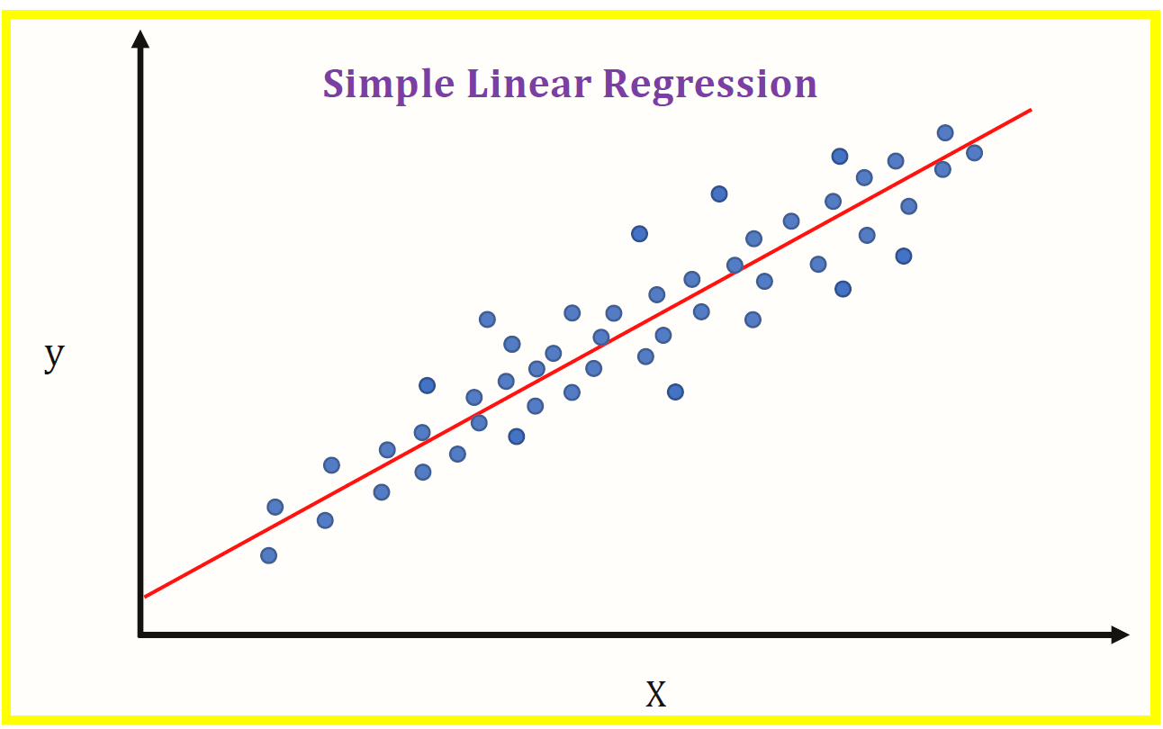
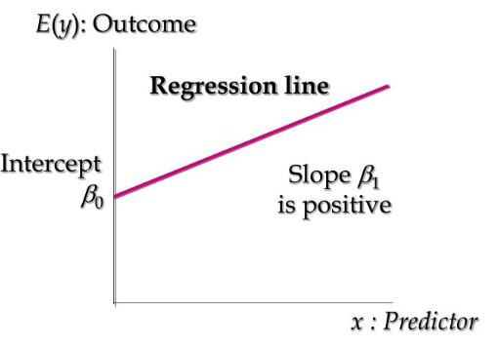
Graph

Slide 7
Advantages of Simple Linear Regression:
Easy to implement: Simple linear regression is a straightforward and easy-to-implement method for modeling a linear relationship between two variables.
Interpretability: Simple linear regression provides a simple and easy-to-interpret relationship between the dependent and independent variables.
Computationally efficient: Simple linear regression is computationally efficient and requires little computational resources, making it suitable for large datasets.
Baseline comparison: Simple linear regression can serve as a baseline for comparison with more complex regression models.

Slide 8
Disadvantages of Simple Linear Regression:
Linearity assumption: Simple linear regression assumes a linear relationship between the dependent and independent variables, which may not always be the case in real-world data.
One independent variable: Simple linear regression only considers one independent variable, which may not capture all of the relevant information in the data.
Independence assumption: Simple linear regression assumes that the observations are independent of each other, which may not always be the case in real-world data.
Outliers: Simple linear regression can be sensitive to outliers, which may have a large impact on the regression line.
Normal distribution: Simple linear regression assumes a normal distribution of the residuals, which may not always be the case in real-world data.

Slide 9
Multiple Linear Regression
Multiple linear regression is a statistical method used to model the linear relationship between multiple independent variables and a dependent variable.
It is used to predict the value of the dependent variable based on the values of the independent variables.
The model is represented as an equation that is a linear combination of the independent variables and their corresponding coefficients, which are estimated from a sample of data using methods such as ordinary least squares.

Slide 10
The mathematical equation of multiple linear regression
Y = β0 + β1X1 + β2X2 + ... + βkXk + ε
where: Y is the dependent variable, X1, X2, ..., Xk are the independent variables, β0, β1, β2, ..., βk are the regression coefficients, representing the effect of each independent variable on the dependent variable, ε is the error term representing the variation in Y not explained by the independent variables.
The goal of multiple linear regression is to estimate the values of the coefficients β0, β1, β2, ..., βk that minimize the sum of squared residuals between the observed values of Y and the values predicted by the model.

Slide 11
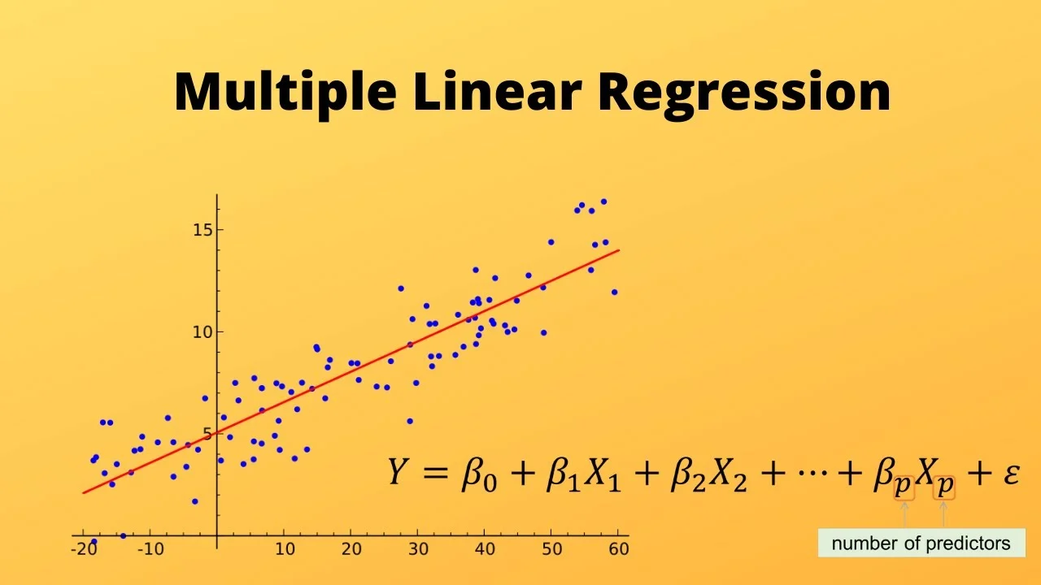
Graph

Slide 12
Advantages of multiple linear regression:
1.Multiple linear regression can handle multiple independent variables, allowing for the examination of the relationship between the dependent variable and multiple independent variables.
2.It is simple and easy to implement
3.The coefficients of the independent variables can be used to determine the relative importance of each independent variable in explaining the variation in the dependent variable.

Slide 13
Disadvantages of multiple linear regression:
The assumptions of linearity and homoscedasticity of errors may not always hold.
The model assumes that the independent variables are not highly correlated with each other (i.e., no multicollinearity), which can lead to unstable and unreliable coefficient estimates.
The model can be prone to overfitting if there are too many independent variables or if the independent variables are highly correlated with each other.

Slide 14
Thank you

